Slide 1
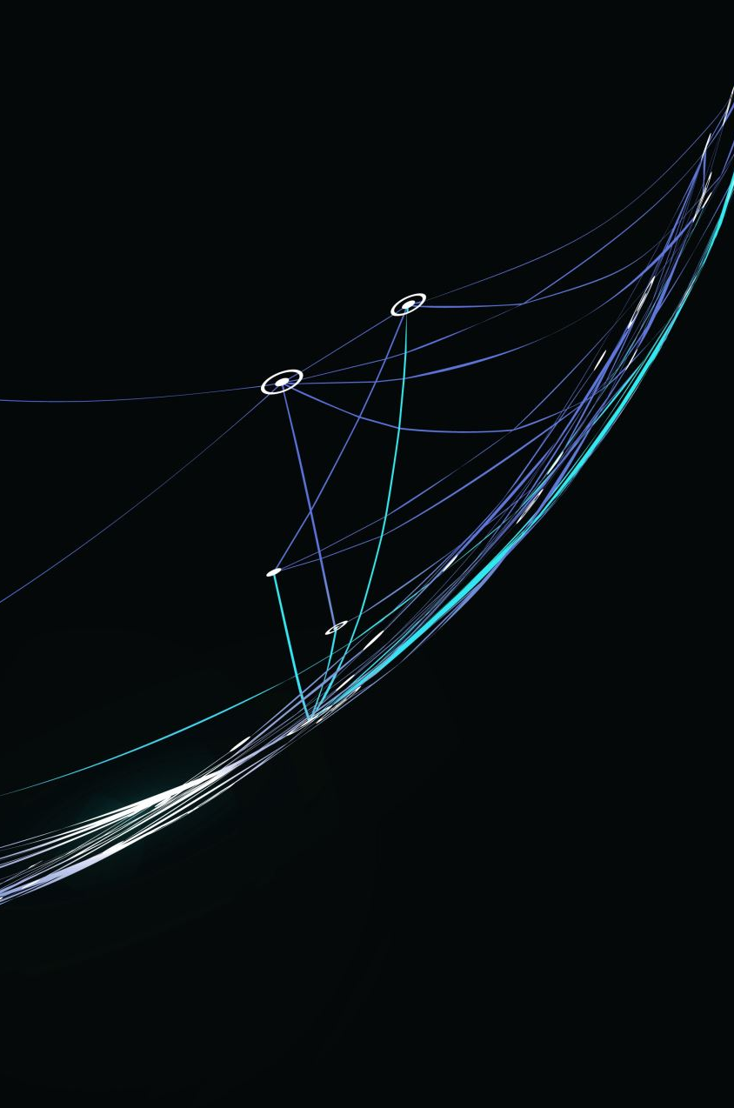

Enclitics and Proclitis
Enklitike i proklitike
BCS 202 Spring 2024

Slide 2
Šta su enkilite i proklitike? What are enclitics and proclitics?
They are unaccented short forms that are usually joined in pronounciation with a neighboring accented word.
Proclitics: before accented word
Enclitics: after accented word

Slide 3
Enklitike Enclitics
Enclitic words never carry an accent
More enclitics forms may occur together in a rigid determined sequence
Example: li, će, joj….

Slide 4
Enclitics Forms

Slide 5
The question particle li
Da li si jeo?
Je li to ona?
Jesi li išao tamo?

Slide 6
Present form of “helping” verbs
Ću, ćeš, će, ćemo, ćete, će
Sam, si, (je), smo, ste, su
Bih bi, bi, bismo, biste, bi (conditional)
Ja ću ići tamo.
Da li ste išli tamo?
On bi da je otišao tamo.

Slide 7
The unemphatic forms of personal pronouns in the dative case
Mi | Meni | To me | Nam | Nama | To us
Ti | Tebi | To you | Vam | Vama | To you
Mu | Njemu | To him/it | im | njima | To them
joj | njoj | To her, to it

Slide 8
The unemphatic form of personal pronouns in the accusative case
me | mene | me | nas | nas | Us
te | tebe | you | vas | Vas | You
ga | njega | Him, it | ih | njih | Them
Ju, je | nju | Her, it

Slide 9
The reflexive form se
Ja se češljam.
Ti se obličiš.
Rakija se pravi od šljive.

Slide 10
The third singular present form of biti, je
On je pametan
Ona je vrlo uspešna.
Dete je malo.

Slide 11
Order
Li has priority
Second place is for sam, ću, bih
Third place for dativ joj, mu, nam
Forth place for accusative ga, je, ih
Fifth postion for se
Sixth postion for the verb form je

Slide 12
Vežba
Textbook, Lesson 14, Vježba 3, page 81

